Slide 1
CS4102 Algorithms
Fall 2018
Warm up
Dynamic Programming in General

Slide 2
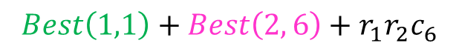
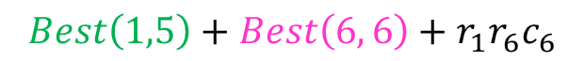
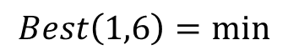
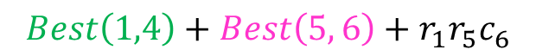

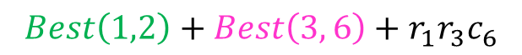
Generic Top-Down Dynamic Programming Soln
Apply to Matrix Chain Multiplication
mem = {}
def myDPalgo(problem):
if mem[problem] not blank:
return mem[problem]
if baseCase(problem):
solution = solve(problem)
mem[problem] = solution
return solution
subsolutions = []
for subproblem of problem:
subsolutions.append(myDPalgo(subproblem))
solution = OptimalSubstructure(subsolutions)
mem[problem] = solution
return solution
$$Best\left(1,1\right)+Best\left(2, 6\right)+r_{1}r_{2}c_{6}$$
$$Best\left(1,2\right)+Best\left(3, 6\right)+r_{1}r_{3}c_{6}$$
$$Best\left(1,6\right)=min$$
$$Best\left(1,3\right)+Best\left(4, 6\right)+r_{1}r_{4}c_{6}$$
$$Best\left(1,4\right)+Best\left(5, 6\right)+r_{1}r_{5}c_{6}$$
$$Best\left(1,5\right)+Best\left(6, 6\right)+r_{1}r_{6}c_{6}$$

Slide 3
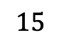
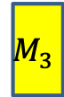
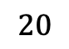

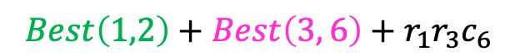
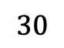
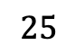
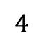
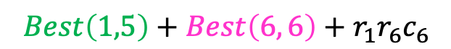
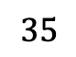
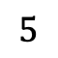
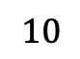
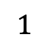
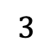
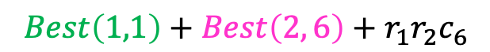
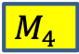
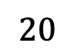
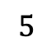
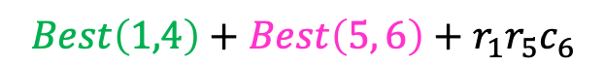
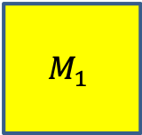
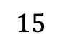
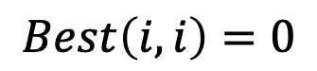
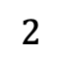
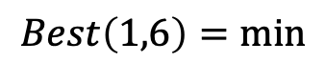
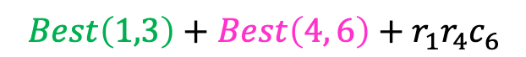
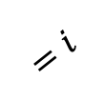

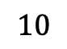
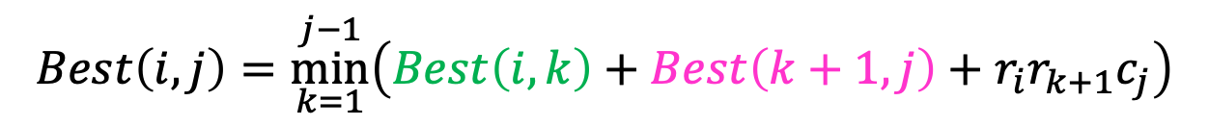
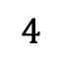
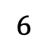
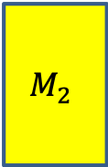
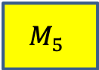

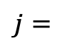
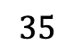

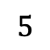
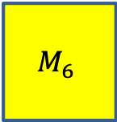
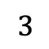
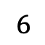
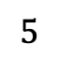
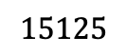
Matrix Chaining
$$35$$
$$15$$
$$5$$
$$10$$
$$20$$
$$25$$
$$M_{1}$$
$$M_{2}$$
$$M_{3}$$
$$M_{4}$$
$$M_{5}$$
$$M_{6}$$
$$30$$
$$×$$
$$35$$
$$×$$
$$15$$
$$×$$
$$5$$
$$×$$
$$10$$
$$×$$
$$20$$
$$Best\left(i,j\right)=\underset{k=1}{\overset{j−1}{min}}\left(Best\left(i,k\right)+Best\left(k+1, j\right)+r_{i}r_{k+1}c_{j}\right)$$
$$j=$$
$$1$$
$$2$$
$$3$$
$$4$$
$$5$$
$$6$$
$$=i$$
$$Best\left(i,i\right)=0$$
0
15750
7875
9375
11875
$$15125$$
$$1$$
0
2625
4375
7125
10500
$$2$$
0
750
2500
5375
$$3$$
$$Best\left(1,1\right)+Best\left(2, 6\right)+r_{1}r_{2}c_{6}$$
0
1000
3500
$$4$$
$$Best\left(1,2\right)+Best\left(3, 6\right)+r_{1}r_{3}c_{6}$$
$$Best\left(1,6\right)=min$$
$$Best\left(1,3\right)+Best\left(4, 6\right)+r_{1}r_{4}c_{6}$$
0
5000
$$5$$
$$Best\left(1,4\right)+Best\left(5, 6\right)+r_{1}r_{5}c_{6}$$
0
$$Best\left(1,5\right)+Best\left(6, 6\right)+r_{1}r_{6}c_{6}$$
$$6$$

Slide 4
Today’s Keywords
Dynamic Programming
Gerrymandering

Slide 5
CLRS Readings
Chapter 15
Chapter 16

Slide 6
Homeworks
Homework 5 due Friday @ 11pm
Dynamic Programming
Python or Java

Slide 7
Dynamic Programming
Requires Optimal Substructure
Solution to larger problem contains the solutions to smaller ones
Idea:
Identify recursive structure of the problem
What is the “last thing” done?
Select a good order for solving subproblems
“Top Down”: Solve each recursively
“Bottom Up”: Iteratively solve smallest to largest
Save solution to each subproblem in memory

Slide 8
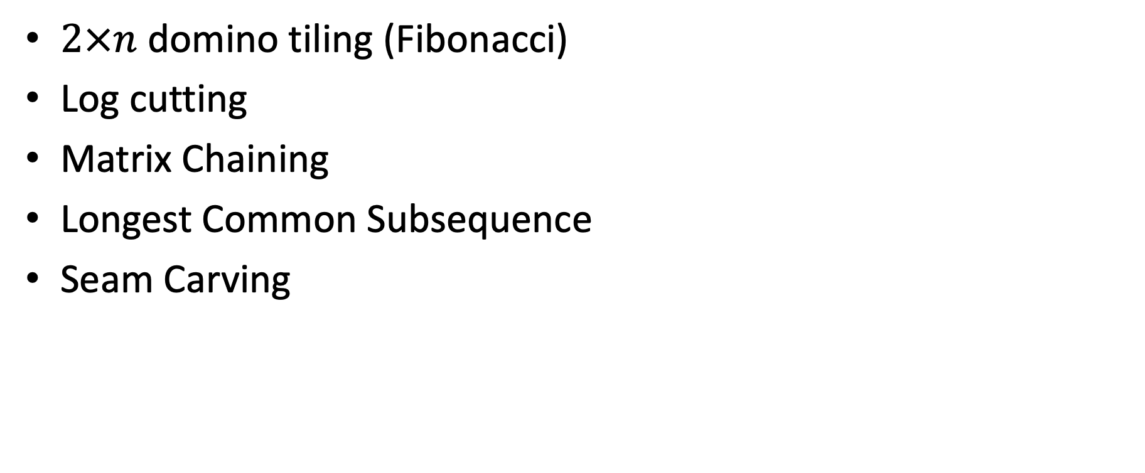
DP Algorithms so far
$2×n$ domino tiling (Fibonacci)
Log cutting
Matrix Chaining
Longest Common Subsequence
Seam Carving

Slide 9
Domino Tiling
Tile(n):
Initialize Memory M
M[0] = 0
M[1] = 0
for i = 0 to n:
M[i] = M[i-1] + M[i-2]
return M[n]
M
0
1
2
3
4
5
6

Slide 10
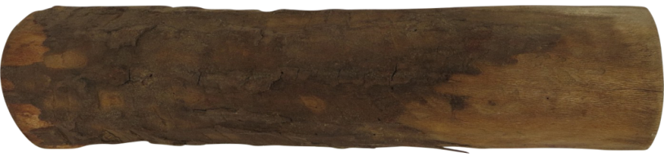

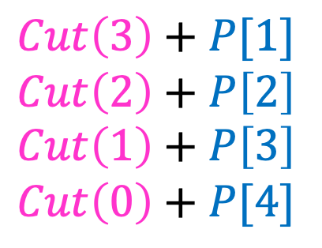

Log Cutting
Solve Smallest subproblem first
$Cut\left(3\right)+P[1]$
$Cut\left(2\right)+P\left[2\right]$
$Cut\left(1\right)+P\left[3\right]$
$Cut\left(0\right)+P[4]$
$Cut\left(4\right)=max⁡$
$Cut(i)$:
0
Length:
0
1
2
3
4
5
6
7
8
9
10
4

Slide 11
Matrix Chaining
$$35$$
$$15$$
$$5$$
$$10$$
$$20$$
$$25$$
$$M_{1}$$
$$M_{2}$$
$$M_{3}$$
$$M_{4}$$
$$M_{5}$$
$$M_{6}$$
$$30$$
$$×$$
$$35$$
$$×$$
$$15$$
$$×$$
$$5$$
$$×$$
$$10$$
$$×$$
$$20$$
$$Best\left(i,j\right)=\underset{k=1}{\overset{j−1}{min}}\left(Best\left(i,k\right)+Best\left(k+1, j\right)+r_{i}r_{k+1}c_{j}\right)$$
$$j=$$
$$1$$
$$2$$
$$3$$
$$4$$
$$5$$
$$6$$
$$=i$$
$$Best\left(i,i\right)=0$$
0
15750
7875
9375
11875
$$15125$$
$$1$$
0
2625
4375
7125
10500
$$2$$
0
750
2500
5375
$$3$$
$$Best\left(1,1\right)+Best\left(2, 6\right)+r_{1}r_{2}c_{6}$$
0
1000
3500
$$4$$
$$Best\left(1,2\right)+Best\left(3, 6\right)+r_{1}r_{3}c_{6}$$
$$Best\left(1,6\right)=min$$
$$Best\left(1,3\right)+Best\left(4, 6\right)+r_{1}r_{4}c_{6}$$
0
5000
$$5$$
$$Best\left(1,4\right)+Best\left(5, 6\right)+r_{1}r_{5}c_{6}$$
0
$$Best\left(1,5\right)+Best\left(6, 6\right)+r_{1}r_{6}c_{6}$$
$$6$$

Slide 12
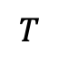
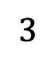
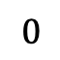






















Longest Common Subsequence
$0$ if $i=0$ or $j=0$
$LCS\left(i−1,j−1\right)+1$ if $X\left[i\right]=Y[j]$
$\max{(LCS\left(i,j−1\right),LCS\left(i−1,j\right))}$ otherwise
$$LCS\left(i,j\right)=$$
$$X=$$
$$A$$
$$T$$
$$C$$
$$T$$
$$G$$
$$A$$
$$T$$
$$Y=$$
$$0$$
$$1$$
$$2$$
$$3$$
$$4$$
$$5$$
$$6$$
$$7$$
$$0$$
0 | 0 | 0 | 0 | 0 | 0 | 0 | 0
0 | 0 | 1 | 1 | 1 | 1 | 1 | 1
0 | 0 | 1 | 1 | 1 | 2 | 2 | 2
0 | 0 | 1 | 2 | 2 | 2 | 2 | 2
0 | 1 | 1 | 2 | 2 | 2 | 3 | 3
0 | 1 | 2 | 2 | 3 | 3 | 3 | 4
0 | 1 | 2 | 2 | 3 | 3 | 4 | 4
$$T$$
$$1$$
$$G$$
$$2$$
$$C$$
$$3$$
$$A$$
$$4$$
$$T$$
$$5$$
$$A$$
$$6$$
To fill in cell $(i,j)$ we need cells $\left(i−1,j−1\right),\left(i−1,j\right),(i,j−1)$
Fill from Top->Bottom, Left->Right (with any preference)

Slide 13






Seam Carving
Start from bottom of image (row 1), solve up to top
Initialize $S\left(1,k\right)=e(p_{1,k})$ for each pixel $p_{1,k}$
For $i>2$ find $S\left(i,k\right)=$
Pick smallest from top row, backtrack, removing those pixels
$$S\left(n−1,k−1\right)+e(p_{n,k})$$
$$S\left(n−1,k\right)+e(p_{n,k})$$
$$S\left(n−1,k+1\right)+e(p_{n,k})$$
$$n$$
Energy of the seam initialized to the energy of that pixel
$$m$$

Slide 14


Slide 15

Gerrymandering
Manipulating electoral district boundaries to favor one political party over others
Coined in an 1812 Political cartoon
Governor Gerry signed a bill that redistricted Massachusetts to benefit his Democratic-Republican Party
The Gerrymander

Slide 16
According to the Supreme Court
Gerrymandering cannot be used to:
Disadvantage racial/ethnic/religious groups
It can be used to:
Disadvantage political parties

Slide 17
VA 5th District

Slide 18
Gerrymandering Today
Computers make it really effective

Slide 19

Gerrymandering Today
Computers make it really effective

Slide 20


Gerrymandering Today
Computers make it really effective

Slide 21
How does it work?
States are broken into precincts
All precincts have the same size
We know voting preferences of each precinct
Group precincts into districts to maximize the number of districts won by my party
Overall: R:217 D:183
R:125 R:92
R:112 R:105
R:65
D:35
R:45
D:55
R:65
D:35
R:45
D:55
R:65
D:35
R:45
D:55
R:60
D:40
R:47
D:53
R:60
D:40
R:47
D:53
R:60
D:40
R:47
D:53

Slide 22

Gerrymandering Problem Statement
Given:
A list of precincts: $p_{1},p_{2},…,p_{n}$
Each containing $m$ voters
Output:
Districts $D_{1},D_{2}⊂\{p_{1},p_{2},…,p_{n}\}$
Where $\left|D_{1}\right|=|D_{2}|$
$R\left(D_{1}\right),R\left(D_{2}\right)>\frac{mn}{4}$
$R(D_{i})$ gives number of “Regular Party” voters in $D_{1}$
$R\left(D_{i}\right)>\frac{mn}{4}$ means $D_{i}$ is majority “Regular Party”
“failure” if no such solution is possible

Slide 23
Dynamic Programming
Requires Optimal Substructure
Solution to larger problem contains the solutions to smaller ones
Idea:
Identify recursive structure of the problem
What is the “last thing” done?
Select a good order for solving subproblems
“Top Down”: Solve each recursively
“Bottom Up”: Iteratively solve smallest to largest
Save solution to each subproblem in memory

Slide 24













Consider the last precinct
$$D_{1}$$
$$D_{1}$$
$k$ precincts
$x$ voters for R
$k+1$ precincts
$x+R(p_{n})$ voters for R
If we assign $p_{n}$to $D_{1}$
Valid gerrymandering if:
$k+1=\frac{n}{2}$,
$x+R\left(p_{n}\right),y>\frac{mn}{4}$
After assigning the first $n−1$ precincts
$$p_{n}$$
$$D_{2}$$
$$D_{2}$$
If we assign $p_{n}$to $D_{2}$
$n−k−1$ precincts
$y$ voters for R
$n−k$ precincts
$y+R(p_{n})$ voters for R
Valid gerrymandering if:
$n−k=\frac{n}{2}$,
$x,y+R\left(p_{n}\right)>\frac{mn}{4}$

Slide 25



Define Recursive Structure
$$S\left(j,k,x,y\right)=$$
True if from among the first $j$ precincts:
$k$ are assigned to $D_{1}$
exactly $x$ vote for R in $D_{1}$
exactly $y$ vote for R in $D_{2}$
$$n × n × mn × mn$$
4D Dynamic Programming!!!

Slide 26


















Two ways to satisfy $S\left(j,k,x,y\right)$:
$$D_{1}$$
$S\left(j,k,x,y\right)=$ True if:
from among the first $j$ precincts
$k$ are assigned to $D_{1}$
exactly $x$ vote for R in $D_{1}$
exactly $y$ vote for R in $D_{2}$
$k−1$ precincts
$x−R(p_{j})$ voters for R
$$p_{j}$$
$$D_{2}$$
Then assign $p_{j}$to $D_{1}$
$j−k$ precincts
$y$ voters for R
$$D_{1}$$
OR
$k$ precincts
$x$ voters for R
$$D_{1}$$
$k$ precincts
$x$ voters for R
$$D_{2}$$
$j−k$ precincts
$y$ voters for R
$$p_{j}$$
$$D_{2}$$
$j−1−k$ precincts
$y−R(p_{j})$ voters for R
Then assign $p_{j}$to $D_{2}$
$$S\left(j,k,x,y\right)=S\left(j−1,k−1,x−R\left(p_{j}\right), y\right)∨S\left(j−1,k,x,y−R\left(p_{j}\right)\right)$$

Slide 27


Final Algorithm
$$S\left(j,k,x,y\right)=S\left(j−1,k−1,x−R\left(p_{j}\right), y\right)∨S\left(j−1,k,x,y−R\left(p_{j}\right)\right)$$
Initialize $S(0,0,0,0)=$ True
for $j=1,…,n$:
for $k=0,…,min⁡(j,\frac{n}{2})$:
for $x=0,…,jm$:
for $y=0,…,jm$:
$S\left(j,k,x,y\right)=$
$$S\left(j−1,k−1,x−R\left(p_{j}\right), y\right)$$
$$∨S\left(j−1,k,x,y−R\left(p_{j}\right)\right)$$
Search for True entry at $S(n,\frac{n}{2},>\frac{mn}{4},>\frac{mn}{4})$
$S\left(j,k,x,y\right)=$ True if:
from among the first $j$ precincts
$k$ are assigned to $D_{1}$
exactly $x$ vote for R in $D_{1}$
exactly $y$ vote for R in $D_{2}$

Slide 28






Run Time
$$S\left(j,k,x,y\right)=S\left(j−1,k−1,x−R\left(p_{j}\right), y\right)∨S\left(j−1,k,x,y−R\left(p_{j}\right)\right)$$
Initialize $S(0,0,0,0)=$ True
for $j=1,…,n$:
for $k=1,…,min⁡(j,\frac{n}{2})$:
for $x=0,…,jm$:
for $y=0,…,jm$:
$S\left(j,k,x,y\right)=$
$$S\left(j−1,k−1,x−R\left(p_{j}\right), y\right)$$
$$∨S\left(j−1,k,x,y−R\left(p_{j}\right)\right)$$
Search for True entry at $S(n,\frac{n}{2},>\frac{mn}{4},>\frac{mn}{4})$
$$n$$
$$\frac{n}{2}$$
$$Θ(n^{4}m^{2})$$
$$nm$$
$$nm$$

Slide 29


$$Θ(n^{4}m^{2})$$
Runtime depends on the value of $m$, not size of $m$
Run time is exponential in size of input
Note: Gerrymandering is NP-Complete

